Slide 1
Impact of price
on visibility
30%
60%
+15%
10%
The percentage of
potential buyers who
will look for property
+10%
Market Value
75%
-10%
90%
-15%
NAR from Move Sales, Inc.

Slide 2
Months Inventory of Homes for Sale
2010
Buyers’
Market
(> 7 Months)
2008
2007
2006
Neutral Market (6-7 Months)
Sellers’
Market
(< 6 Months)
1999
Today
NAR
Notes:
nar.realtor
https://www.nar.realtor/topics/existing-home-sales
https://www.nar.realtor/newsroom/existing-home-sales-jump-6-5-in-February
Source Slide: October 2020 Monthly Market Report Slide #12

Slide 3
What those same analysts and
others just forecasted for Q3
Four of the original five forecasters
Additional three forecasters
0%
Notes:
https://markets.businessinsider.com/news/stocks/economic-outlook-goldman-cuts-us-gdp-estimate-growth-expectations-q3-2020-7-1029369080#
https://www.newyorkfed.org/research/policy/nowcast
https://www.cnbc.com/rapid-update/
https://conference-board.org/research/us-forecast
https://www.calculatedriskblog.com/2020/07/early-q3-gdp-forecasts.html
https://www08.wellsfargomedia.com/assets/pdf/commercial/insights/economics/monthly-outlook/monthly-20200709.pdf
https://am.jpmorgan.com/us/en/asset-management/gim/adv/insights/market-insights/weekly-economic-update
Source Slide: August 2020 Monthly Market Report Slide #5

Slide 4
Unemployment Rates and Home Sales
Do Not Have a Direct Relationship
3
1
Unemployment Rate (Line)
Existing Home Sales (Bars)
2
4
U.S. Bureau of Labor Statistics, NAR
Notes:
https://www.nar.realtor/research-and-statistics/housing-statistics/existing-home-sales
https://data.bls.gov/timeseries/LNU04000000?years_option=all_years&periods_option=specific_periods&periods=Annual+Data
https://data.bls.gov/timeseries/LNS14000000
Source Slide: April 2020 Monthly Market Report Slide #29

Slide 5
an astonishing rebound…
-Realtor.com
Shockingly Strong
-HousingWire
“Pulled something of a high-wire act in the second quarter” -ATTOM Data Solutions
Stared the pandemic right in the eye and hasn’t blinked.
-Zillow
Has been nothing short of remarkable –Meyers Research
Notes:
Source Slide: August 2020 Monthly Market Report Slide #7

Slide 6
Housing Market Recovery Index
4 Components:
1. Demand
2. Supply
3. Price
4. Time on Market
February 1st Baseline = 100
realtor.com
Notes:
https://news.move.com/2020-09-24-Realtor-com-R-Weekly-Housing-Report-Nearly-400-000-Fewer-Homes-Have-Been-Listed-Since-the-Start-of-the-Pandemic
Source Slide: October 2020 Monthly Market Report Slide #3

Slide 7
Year-Over-Year Changes in Key Metrics
ShowingTime, MBA, Zillow, NAR, NAHB
Notes:
www.showingtime.com/blog/august-2020-showing-index-results/ www.mba.org www.nar.realtor https://www.nahb.org/
Source Slide: October 2020 Monthly Market Report Slide #4

Slide 8
Change in Showing Traffic*
*Weekly showings normalized to the first calendar week of January, 7-day moving average.
ShowingTime
Notes:
https://www.showingtime.com/impact-of-coronavirus/
Source Slide: September 2020 Monthly Market Report Slide #2

Slide 9
“Whether in terms of pending contract activity or our proprietary buyer demand ratings, the various measures of demand captured in this month’s survey can only be described as shockingly strong, in spite of the resurgence in COVID-19 cases.”
Zelman’s Broker Survey
Notes:
file:///C:/Users/Steve%20Harney/Downloads/I-RESurvey20200727a.pdf (subscription required)
Source Slide: August 2020 Monthly Market Report Slide #10

Slide 10
Purchase Applications
Year-Over-Year Difference
seasonally adjusted
MBA
Notes:
https://www.mba.org/news-research-and-resources/newsroom
Source Slide: September 2020 Monthly Market Report Slide #4

Slide 11
Year-Over-Year Change in Listings
move.com
Notes:
https://news.move.com/2020-09-24-Realtor-com-R-Weekly-Housing-Report-Nearly-400-000-Fewer-Homes-Have-Been-Listed-Since-the-Start-of-the-Pandemic
Source Slide: October 2020 Monthly Market Report Slide #19

Slide 12
National Association of Realtors
Census
Notes:
https://www.nar.realtor/newsroom/existing-home-sales-hit-highest-level-since-december-2006
https://twitter.com/dietz_econ
Source Slide: October 2020 Monthly Market Report Slide #20

Slide 13
Surge in Urban High-End Listings
Month-Over-Month Increase
Zillow
Notes:
http://zillow.mediaroom.com/index.php?s=28775&item=137617
Source Slide: August 2020 Monthly Market Report Slide #21

Slide 14
Median Seller Tenure
in Their Home
Since 1985
NAR
Notes:
https://www.nar.realtor/research-and-statistics/research-reports/highlights-from-the-profile-of-home-buyers-and-sellers
Source Slide: February 2020 Monthly Market Report Slide #25

Slide 15
Percentage of
Homeowner
Equity 2020
John Burns Consulting
Notes:
https://www.realestateconsulting.com
Source Slide: October 2020 Monthly Market Report Slide #13

Slide 16
of all homes in America have at least 60% equity
58.7%
Americans are sitting on tremendous equity
42.1%
of all homes are owned
‘free and clear’
$177,000
the average equity of the mortgaged homes
John Burns Consulting
CoreLogic
Notes:
https://www.realestateconsulting.com
https://www.corelogic.com/insights-download/loan-performance-insights-report.aspx
Source Slide: May 2020 Monthly Market Report Slide #12

Slide 17
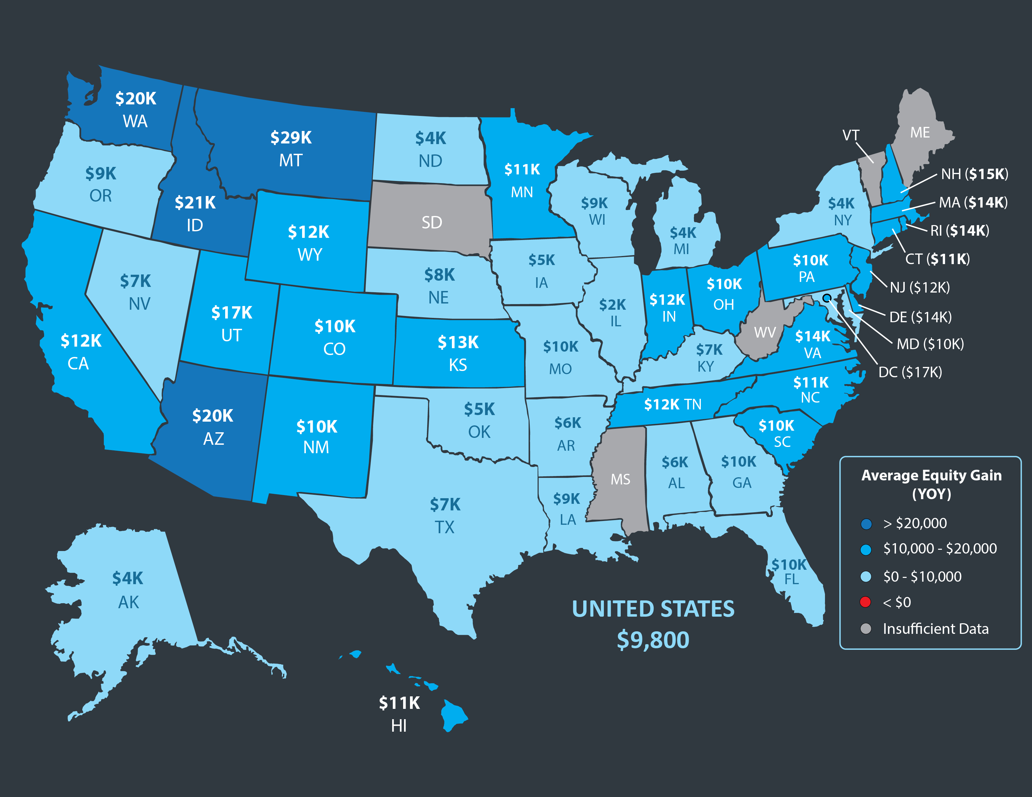
Q2 2020 YOY Homeowner Equity Gain
CoreLogic
Notes:
https://www.corelogic.com/insights-download/homeowner-equity-report.aspx
Source Slide: October 2020 Monthly Market Report Slide #24

Slide 18
“As homeowners gain equity in their homes, they are more likely to consider using that equity to purchase a larger or more attractive home – the wealth effect of rising equity. In today’s housing market, fast rising demand against the limited supply of homes for sale has resulted in continued house price appreciation.”
Mark Fleming
Chief Economist at First American
Notes:
https://blog.firstam.com/economics/housing-market-potential-reaches-highest-level-since-2007
Source Slide: October 2020 Monthly Market Report Slide #23

Slide 19
“The high level of equity provides options for homeowners, policymakers, mortgage investors and servicers in helping to avoid downstream foreclosure activity and default-related losses.”
Black Knight
Notes:
https://cdn.blackknightinc.com/wp-content/uploads/2020/06/BKI_MM_Apr2020_Report.pdf
Source Slide: July 2020 Monthly Market Report Slide #10

Slide 20
Q2 2020 U.S. Home Sales Report
“Home sellers nationwide realized a gain of $75,971 on the typical sale, up from the $66,500 in the first quarter of 2020 and from $65,250 in the second quarter of last year. The latest figure, based on median purchase and resale prices, marked yet another peak level of raw profits in the United States since the housing market began recovering from the Great Recession in 2012.”
ATTOM
Notes:
https://www.attomdata.com/news/market-trends/home-sales-prices/attom-data-solutions-q2-2020-u-s-home-sales-report/
Source Slide: August 2020 Monthly Market Report Slide #23

Slide 21
“As we navigate the unprecedented impact of COVID-19, home has taken on added significance and there are signs that homeownership remains one of the main tenants of the American Dream.”
Mark Fleming
Chief Economist at First American
Notes:
https://blog.firstam.com/economics/millennial-homeownership-delayed-but-not-denied
Source Slide: July 2020 Monthly Market Report Slide #12

Slide 22
Homeownership is an important source of wealth creation, enabling current homeowners and succeeding generations to
move up the economic ladder.
Notes:
https://www.nar.realtor/research-and-statistics/research-reports/home-price-gains-by-years-of-tenure
Source Slide: April 2020 Monthly Market Report Slide #32

